Slide 1
Spatial Analysis of Air Quality Across Salford University
Spatial Distribution and Critical Evaluation of Air Quality Metrics across Campus Environment

Slide 2
Content Layout
Introduction & Rationale
Key Variables & Relevance
Methodology And Sampling Strategy
Statistical Findings
Spatial Distribution
Limitations of Report
Recommendations
Follow on Study
Reference List

Slide 3
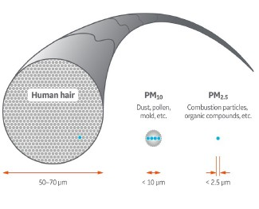
Introduction & Rationale
Air pollution is a major global health issue, responsible for around 6.7 million deaths annually. One of the most important pollutants is particulate matter, which exists mainly as PM10 and PM2.5 (WHO, 2023).
The key difference is their size, with PM2.5 being smaller and more dangerous because it can penetrate deeper into the lungs. Based on this, this study focuses on measuring particulate matter levels across 10 sampling points in Salford University.
Figure 1: Comparison of PM particles to a human hair (CAP, 2023).

Slide 4
Key Variables & Their Relevance
EXPLANATION:
PM2.5: Fine particles that penetrate deep into the lungs, posing significant health risk
PM10: Coarser particles that affect air quality and respiratory health but larger size than PM2.5
Co2: Indicator of human activity and ventilation levels
Temperature & Humidity: Environmental factors influencing pollutant dispersion
SOURCES OF PM:
Vehicle emissions (exhaust, brake & tire wear)
Road dust resuspension
Construction activities
Industrial emissions
Biomass burning (wood, waste, bush burning)
Cooking activities
Cigarette smoke
Natural sources (pollen, spores, sea salt)
Secondary formation from atmospheric gases (SO₂, NOx, NH₃, VOCs)

Slide 5
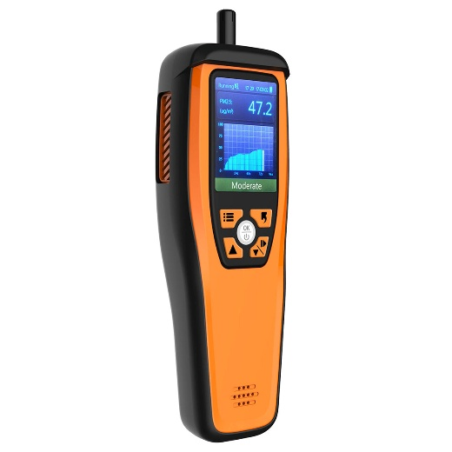

Methodology and Sampling Strategy: Data Collection method
Field based air quality monitoring conducted at Salford University
Data collected from 10 sampling locations across different environments
Parameters measured: PM2.5, PM10, CO₂, temperature, humidity
Handheld monitors used: Temtop M2000 and Airing-2000 Series
Each location sampled for 15 minutes
Temtop M2000
Temtop Airing-2000

Slide 6
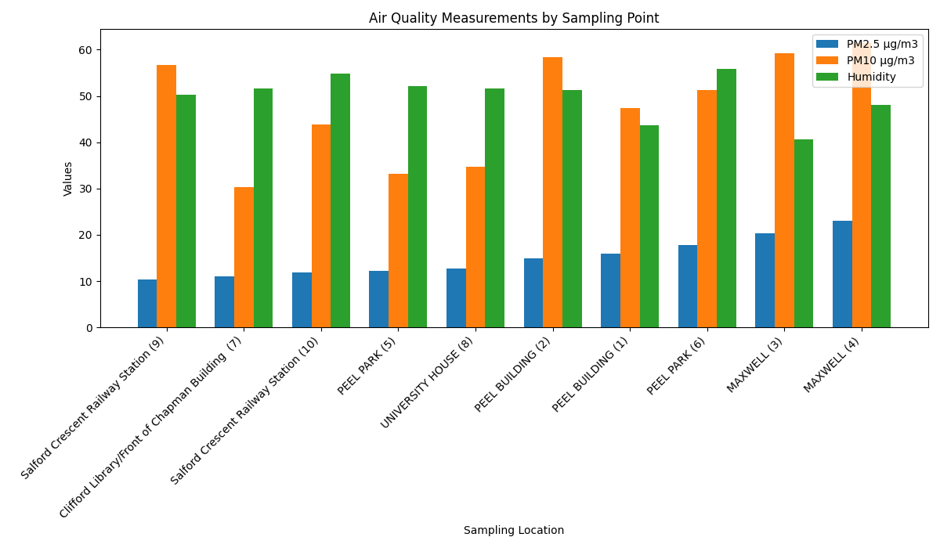
Methodology and Sampling Strategy: Data Preprocessing and Analysis
Data processed and analysed using Python and it libraries
Data cleaning performed to ensure consistency and accuracy
Descriptive statistics used to summarise pollutant levels
Visualisation techniques (bar charts, scatter plots) used to identify patterns
Correlation and map plot analyses were conducted to explore relationships and identify hotspots.
Average PM’s and Humidity Grouped by each Sampling Point.

Slide 7
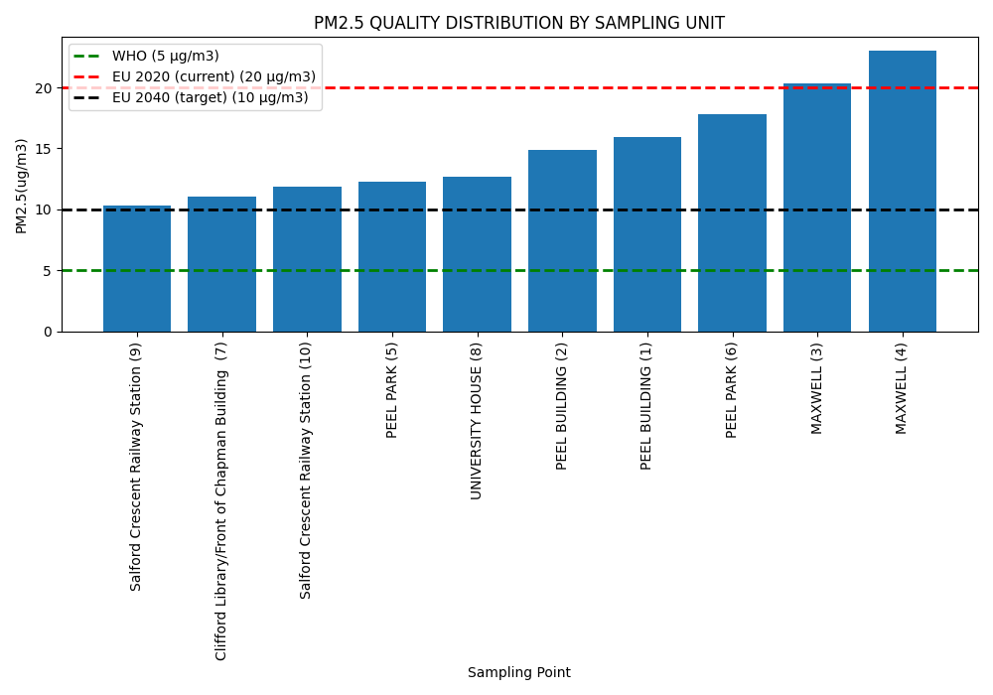
Statistical findings 1. PM2.5 vs global safety standard
More recently, there have been changes to UK statutory standards and WHO guidelines for PM2.5, with the UK annual limit being amended to 20 µg/m3 from 2020, while the WHO guideline has been reduced further to 5 µg/m3. The UK has set a target annual limit for PM2.5 of 10 µg/m3 to be achieved by 2040 (under provisions of the Environment Act 2021).
PM2.5 vs EU and WHO Safety Standard

Slide 8
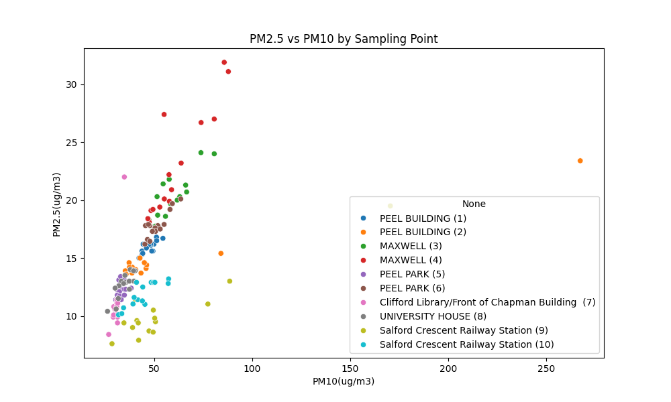
Statistical findings 2. relationship plot (PM 2.5 & pm10)
A positive linear relationship exists between PM10 and PM2.5
Higher PM10 concentrations are associated with higher PM2.5 levels
Relationship Between PM2.5 and PM10

Slide 9
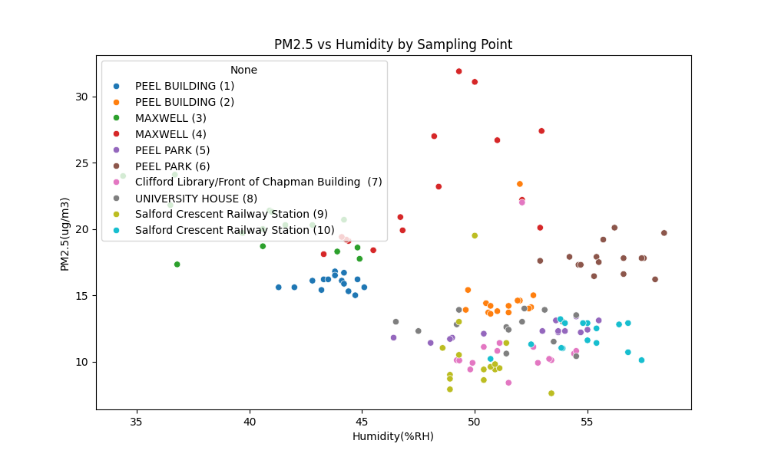
STATISTICAL FINDINGS 3. relationship plots (pm2.5 & humidity)
A negative linear relationship between PM2.5 and Humidity but noise in some sampling point
Lower Humidity are associated with higher PM2.5 concentration
Relationship Between PM2.5 and Humidity

Slide 10
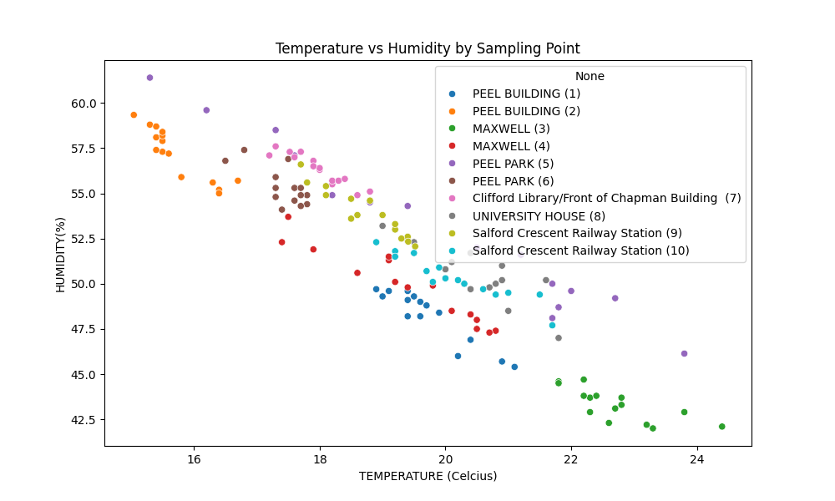
Statistical findings 4. Relationship Plot (Humidity & temperature)
A negative linear relationship between humidity and temperature
Lower Temperature is associated with Higher Humidity
Relationship Between Temperature & Humidity

Slide 11
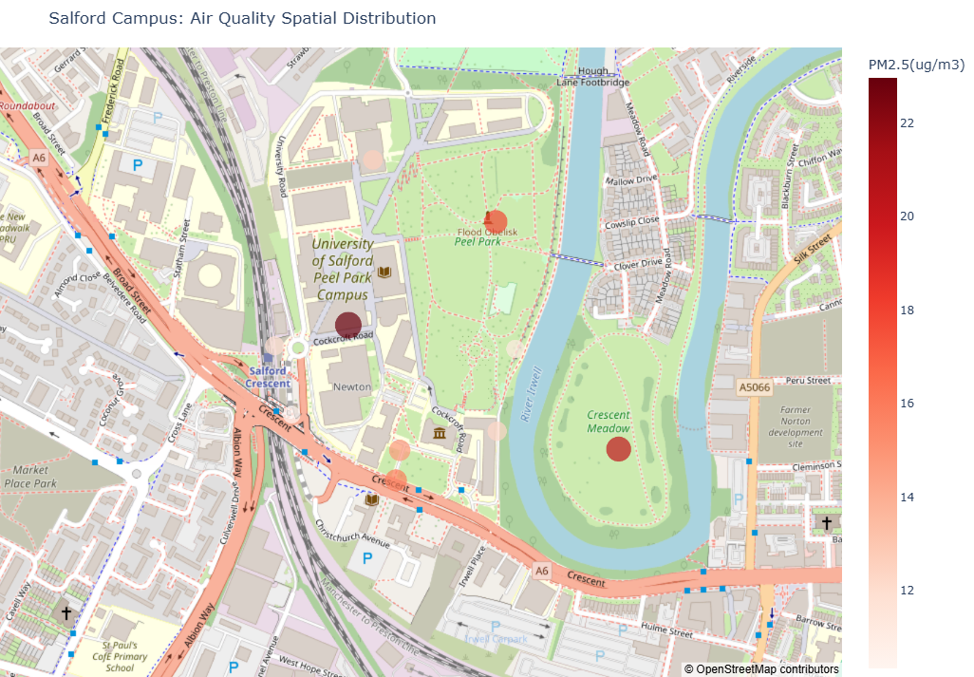
Spatial distribution
Highest PM2.5 concentration is Maxwell(4)
Least PM2.5 concentration is Salford Crescent Railway Station (9)
Map Plot Based on PM2.5 Intensity

Slide 12
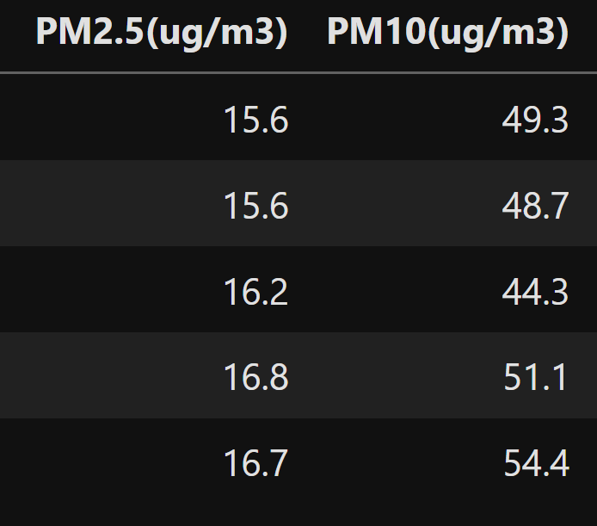
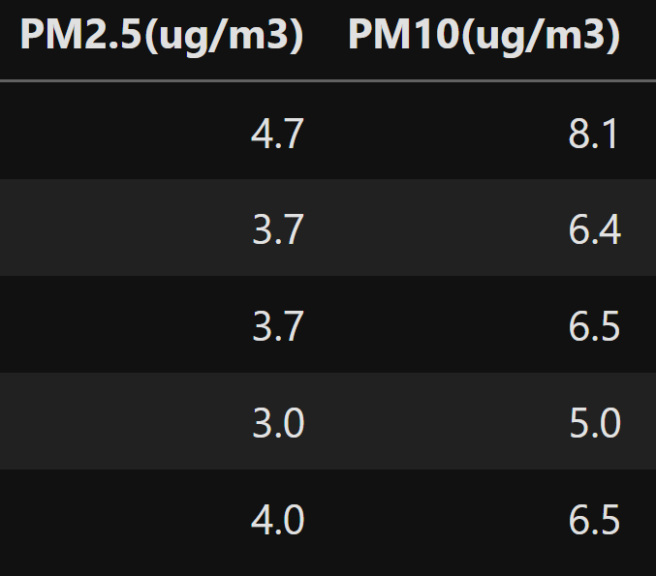
Limitations
EQUIPMENT INCONSISTENCY
MITIGATION STRATEGY (Data Selection)
IMPACT ON RESEARCH DESIGN
First 5 minute readings from Peel Building using Airing-2000 Series
First 5 minute readings from Peel Building using M-2000 Series

Slide 13
RECOMMENDATION
2. BLUE-GREEN INFRASTRUCTURES
1. TARGETED TRAFFIC CONTROL
3. STANDARDISATION OF MONITORING EQUIPMENT
4. EXTENDED MONITORING DURATION ACROSS TIME PERIODS

Slide 14
FOLLOW ON STUDY
EXPLORING NON-LINEAR AND THRESHOLD EFFECTS OF HUMIDITY ON PM2.5: A MICRO-ENVIRONMENTAL STUDY AT MAXWELL AND PEEL PARK BUILDING
Red Dot For Maxwell (4) outlier behaviour

Slide 15
Reference list
WHO (2023). Household air pollution. Available at: https://www.who.int/news room/fact-sheets/detail/household-air-pollution-and-health.
Radaideh, j. a., Abu salem, z. and Alqawasmeh, h 2023. Sensitivity of particulate matter (pm) to climatic variables in arid regions. available at v18i03a124_ywxk4-bj3uqypdovkmg0t.pdf
Python Software Foundation. (2026). Python Language Reference, version 3.x. Available at: https://www.python.org.
Hunter, J. D. (2007). Matplotlib: A 2D graphics environment. Computing in Science & Engineering, 9(3), pp. 90–95.
Waskom, M. L. (2021). Seaborn: statistical data visualization. Journal of Open Source Software, 6(60), p. 3021.
Plotly Technologies Inc. (2015). Collaborative data science. Montréal, QC: Plotly Technologies Inc. Available at: https://plot.ly.
OpenStreetMap Foundation (OSMF). (2026). OpenStreetMap data. Available at: https://www.openstreetmap.org.

